Slide 1
Tomorrow’s Ireland
Roshin Sen and Ciaran Judge
6 March 2024

Slide 2
The big picture

Slide 3
Stand up if…

Slide 4
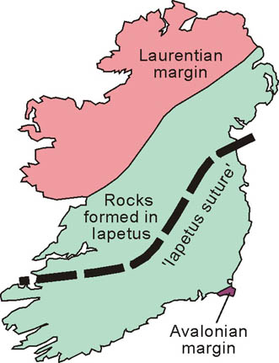

Slide 5



Slide 6
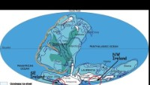

Slide 7
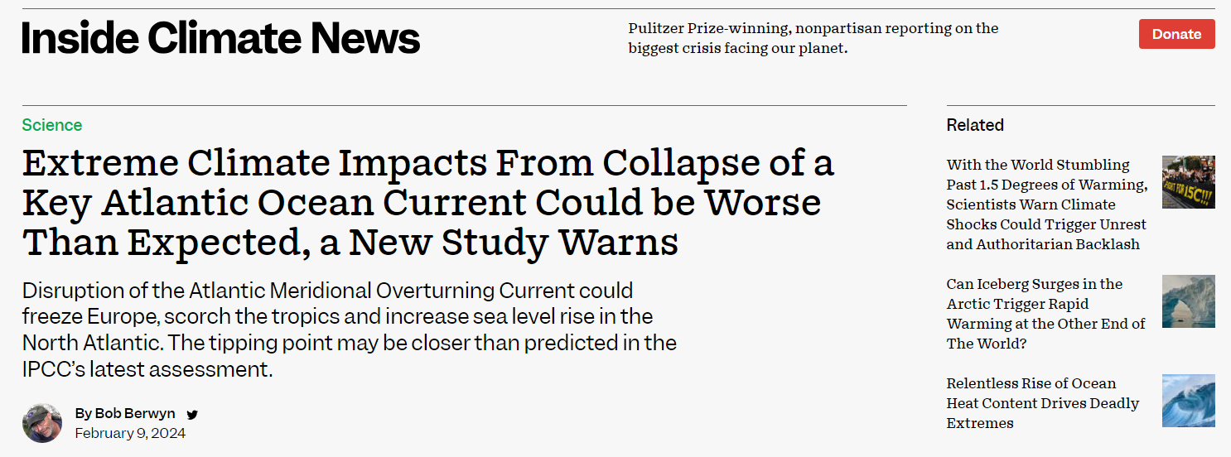
The next 100 years: hot or not?

Slide 8
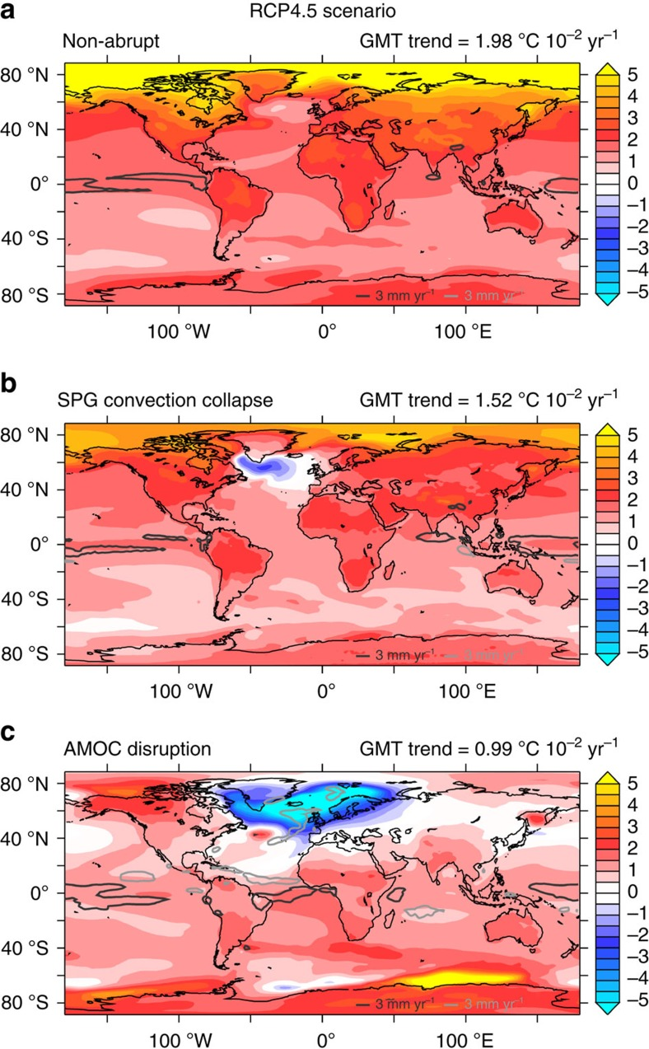
The next 100 years: roasting

Slide 9
The next 100 years: grand

Slide 10
The next 100 years: freezing

Slide 11
Summary so far
On average over the last 500 million years, Ireland is
Somewhere near the equator
Mainly under water
On average, in the next 100 years, Ireland’s climate will be
Grand
Extremes matter as well as averages – drunkard’s walk

Slide 12
Economy and labour market

Slide 13
Stand up if…
Notes:
You’ve worked outside Ireland
You’ve worked outside the Civil Service

Slide 14
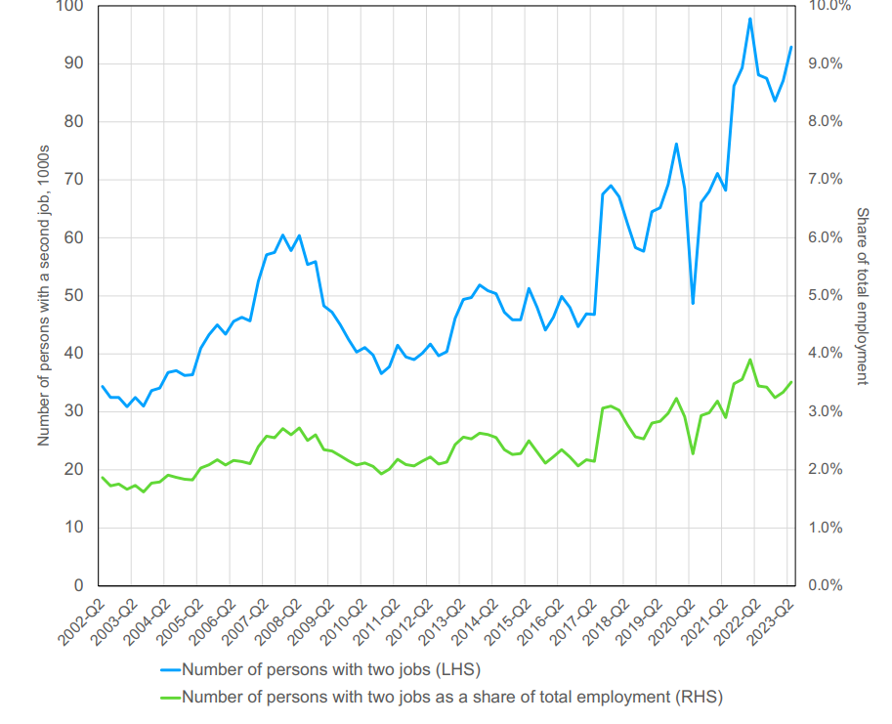
Numbers in employment are record high (over 2.7 million) and unemployment remains below 5%. Structural changes?
DETE IGEES paper found increase in the prevalence of people with second jobs – up from 30-35,000 20 years ago to over 90,000
Increase in its share of total employment from 2% to 3.5% - still below EU average of 3.9%
Notes:
Numbers in employment at series high, unemployment below 5%, etc
There is an increase in the number of people with second jobs – there were about 30-35,000 20 years ago, and it’s increased to over 90,000. As a share of total employment, it remains low – it was around 2% and has increased to around 3.5%, which remains below EU average of 3.9%.
It is likely that this is also an underestimate – DETE paper estimates could be closer to 200,000 using revenue definition.
Labour+market+dynamics+and+the+rising+incidence+of+multiple+jobs+-+Williamson.pdf (squarespace.com)eased prevalence of people holding second jobs -

Slide 15
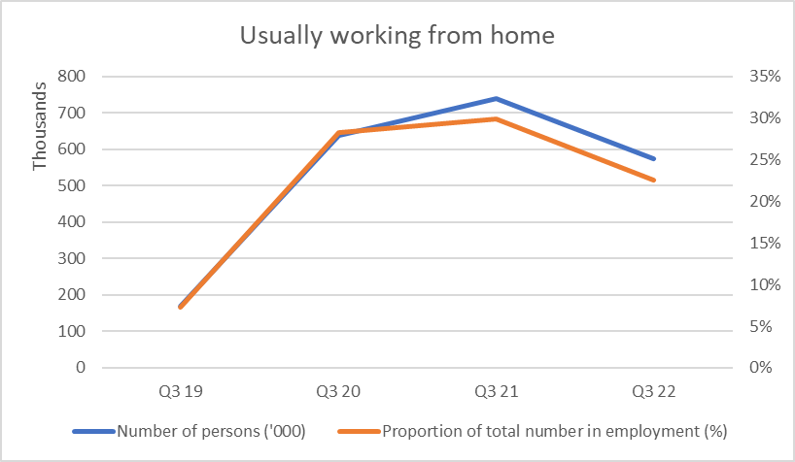
Also increase in remote/blended work
In Q3, 2019 there were 169,300 people usually working from home – increased to 738,900 in 2021 and fell to 574,100 in Q3, 2023
Increase in its share of total employment from 7% in 2019 to 30% in 2021, to 22.5% in 2023
Notes:
Usually working from home means worked at least half of the days worked in previous four weeks
From LFS detailed employment series

Slide 16
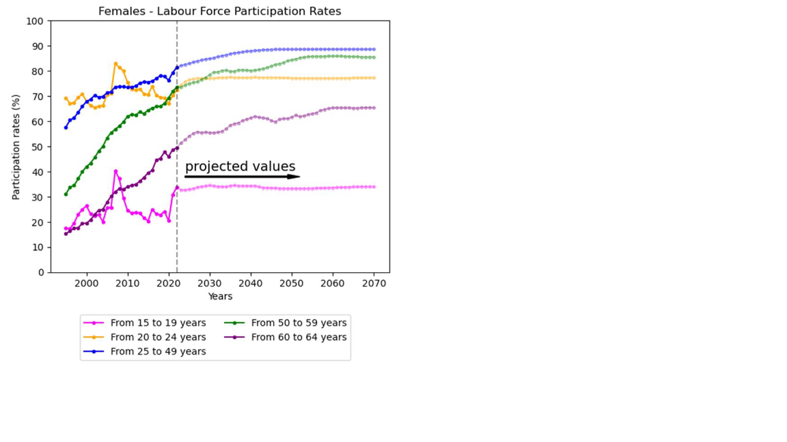
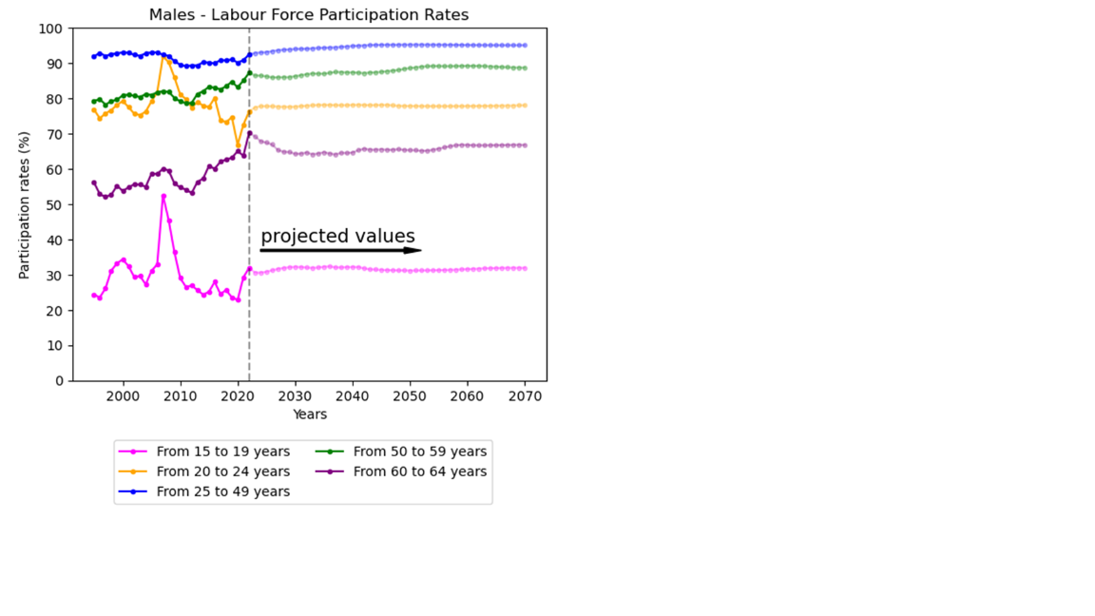

Slide 17
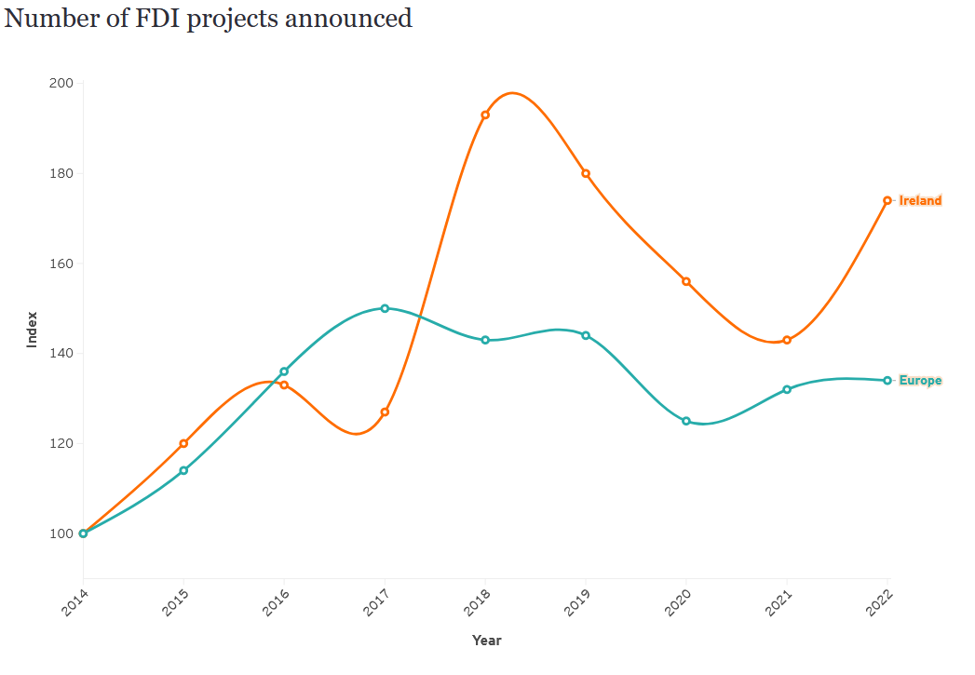
Future of FDI: hot or not?

Slide 18
Future of FDI: hot or not?
EU membership
Educated, English speaking, youthful workforce
Great climate!
Great infrastructure!
Legendary culture!

Slide 19


Slide 20
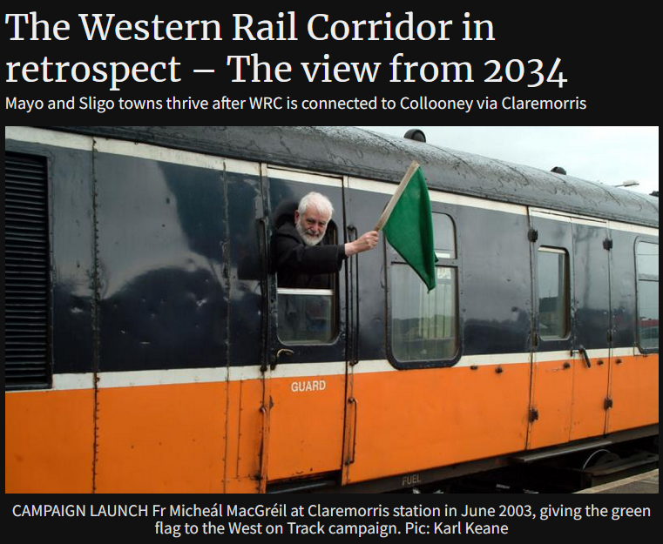

Slide 21
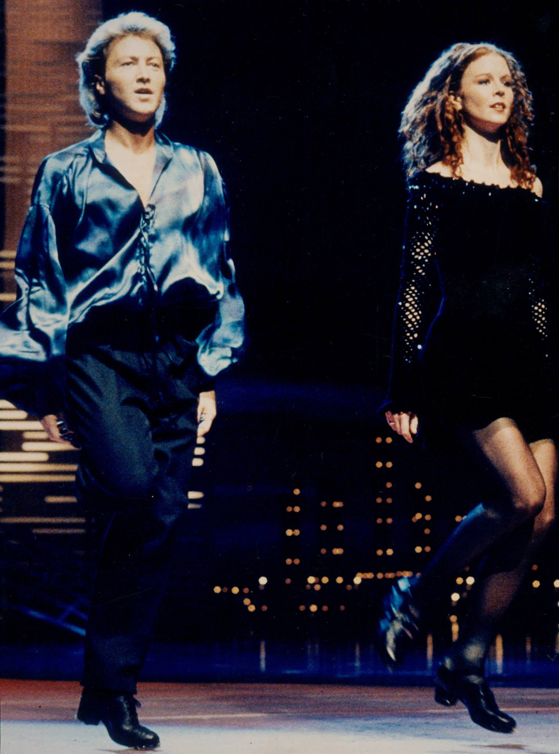

Slide 22
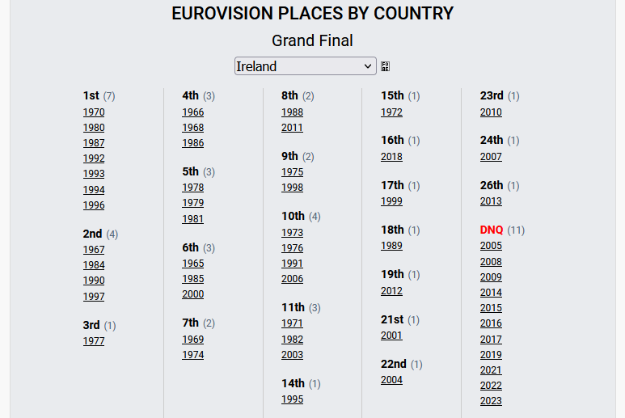

Slide 23
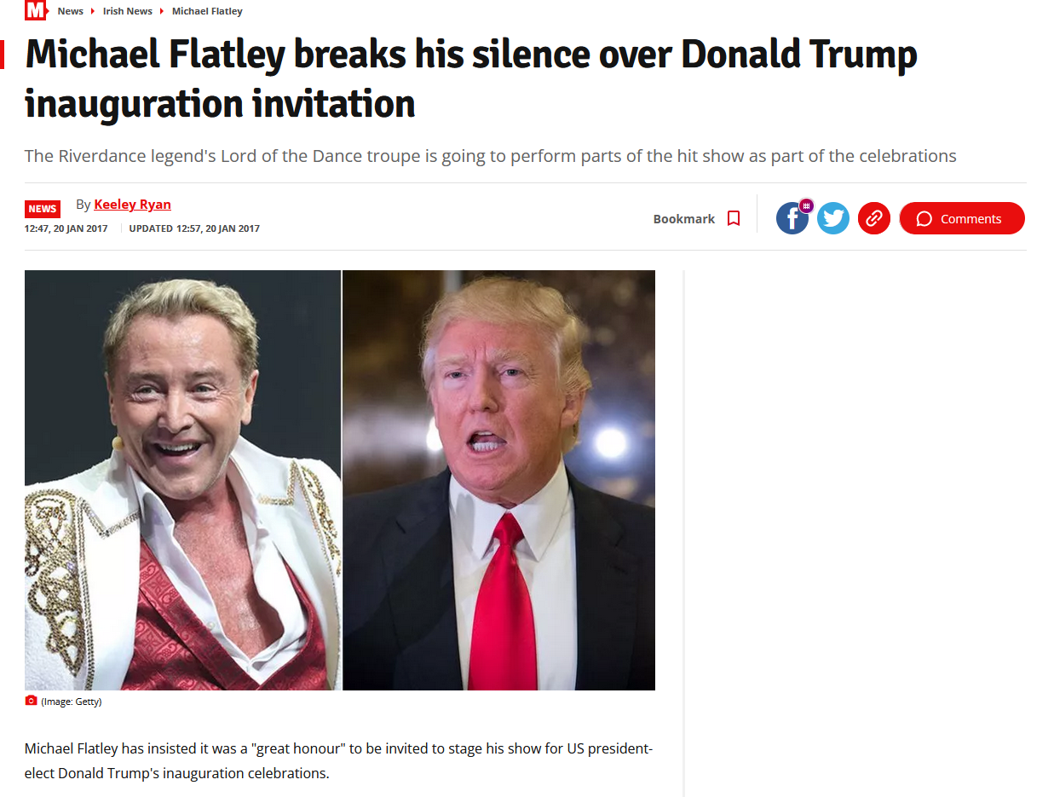

Slide 24
Population

Slide 25
Stand up if…
Notes:
You’re over the Irish median age

Slide 26
Steadily increasing since 1960s
Notes:
The population in Ireland has been steadily increasing since the 1960s
This is unlike most other developed countries (need stats)
We are still at population levels below pre-Famine

Slide 27
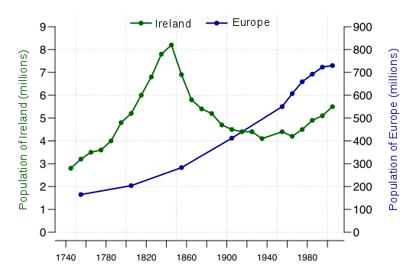
Still some catching up to do

Slide 28
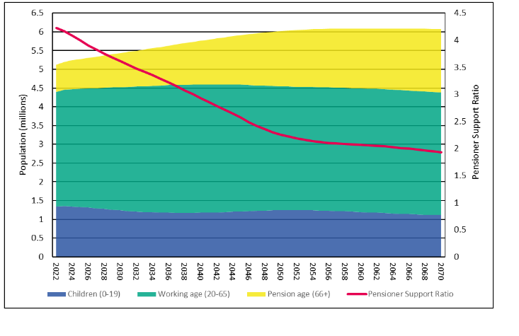
2024 ADL Actuarial Review

Slide 29
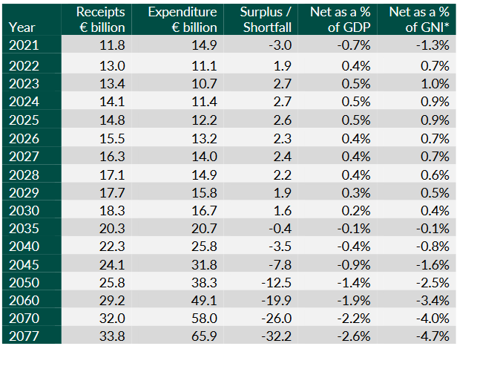
2024 ADL Actuarial Review

Slide 30
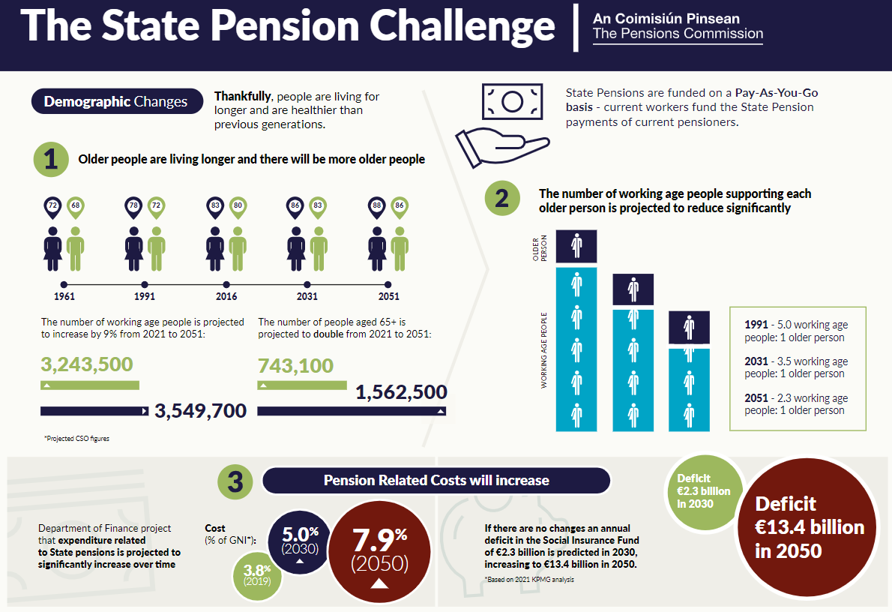
Notes:
Our population is ageing
This is because we are living longer and thankfully healthier lives.
As a consequence, it is estimated that the number of people aged 65 and over will more than double by 2051 while the working age population will increase by 9%. This means the ratio of working age to 65+ will change from around 4.5:1 to 2.3:1 by 2051.
It’s been famously said that the demographics will look after themselves. The CSO estimated that to retain the population ratio of 4.5 to 1 out to 2051 would require an additional 3.3 million working age migrants coming in, above the scenario with the highest level of migration – that’s 85% higher than M1 forecast - and the reaction so far to the current levels of migration has not been wholly positive.

Slide 31
Disability and health

Slide 32
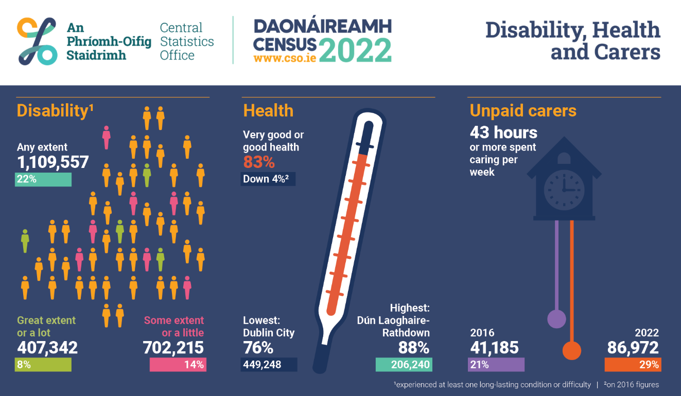
Notes:
Another impact of the ageing population – and timely given the referendum this week – is the implications for long-term care needs.
The one figure to highlight here is the proportion of people spending 43 hours or more on unpaid care – increased from 21% in 2016 to 29% in 2022. This is an extraordinary increase. [CHECK WHO THEY ARE CARING FOR]
For context, end 2022 we had 92,175 carer’s allowance recipients and another 3,505 on CB
157,807 in receipt of DA and 56,450 on IP

Slide 33
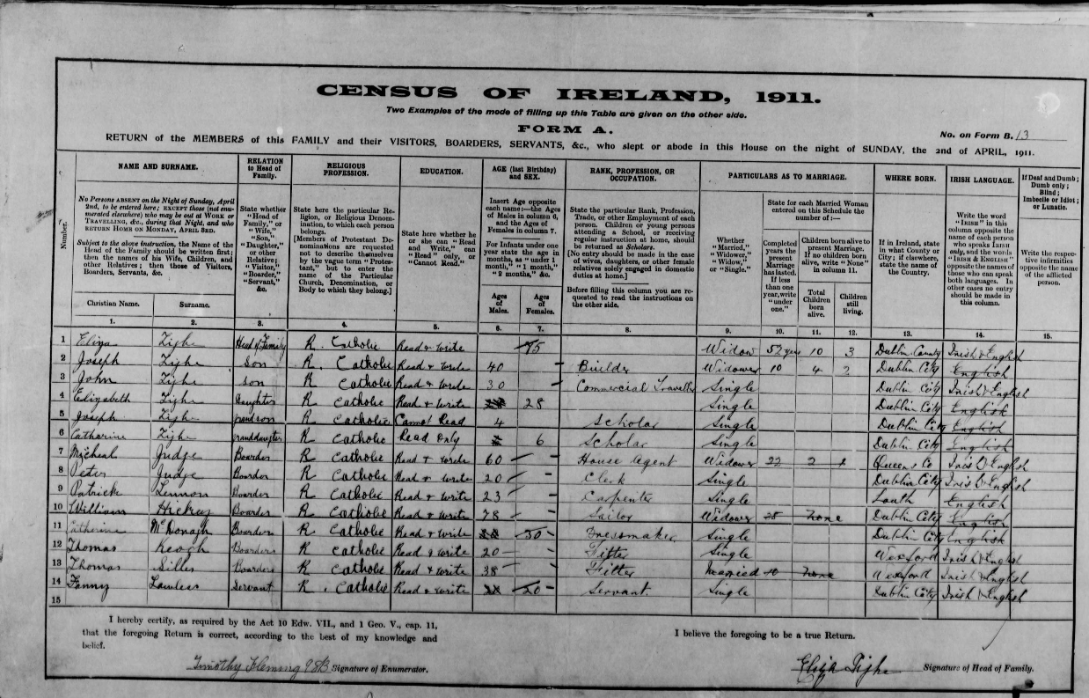
Notes:
Joseph was born in 1869, when the Tighes lived in South Anne Street, and he married Mary McDonagh in 1901. They lived in Summerhill (I had some recollection of discovering that there was some sort of cattle-connected activity nearby, but I think it was just that a few of the neighbours have the occupation “dairy” beside their names in Thom’s Directory, which doesn’t necessarily mean that the dairying activity was happening locally).
Their children were
Μαρψ Ελιζαβετη, βορν 1902, διεδ 1903, “τυβερχυλαρ μενινγιτισ”;
ϑοην, βορν Αυγ 1903, διεδ Νοϖ 1903, “βρονχηο−πνευμονια”;
Κατηλεεν, βορν 1904 – τηε ονλψ ονε ωηο (Ι τηινκ) μαψ ηαϖε συρϖιϖεδ λονγ ενουγη το μαρρψ, τηουγη Ι’ϖε νο σολιδ ινφορματιον ον τηατ;
ϑοσεπη, βορν 1906, συρϖιϖεδ υντιλ 1925 ωηεν ηε διεδ, αγεδ 18, οφ “πυλμοναρψ τυβερχυλοσισ”;
Ανγελα, βορν 1908, διεδ 1909, “βρονχηιτισ”.
Joseph’s wife Mary died in 1909, aged 31, of “phtisis pulmonaria” (TB).
And to round off this extremely sad story, Joseph himself died of “acute pleurisy” in May 1916, aged 47. His mother Eliza, who was suffering from heart disease, outlived him by one month.

Slide 34
Stand up if…
Notes:
You’ve lived abroad
You’ve got an immediate family member living abroad
You were born outside of the island of IReland

Slide 35
Migration

Slide 36
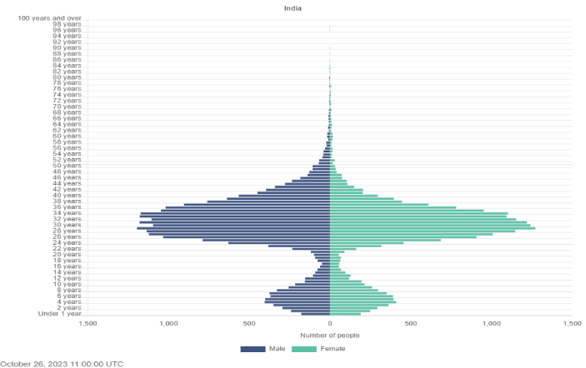
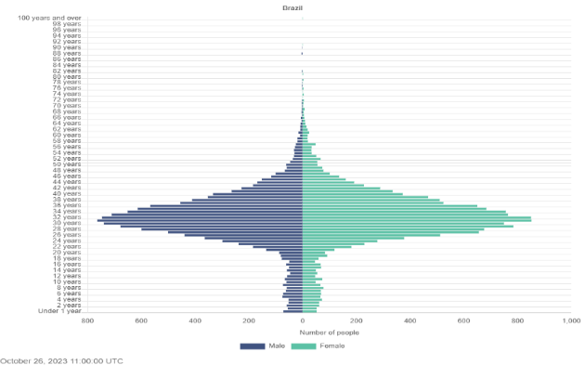
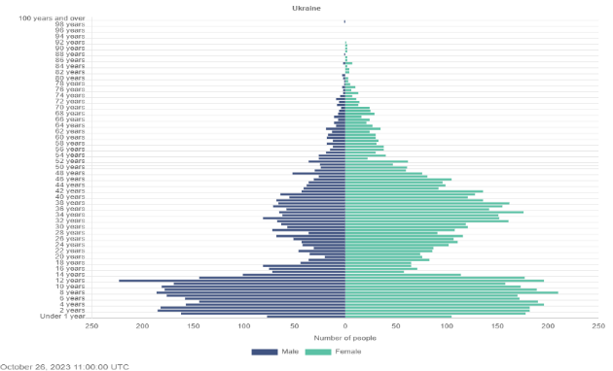
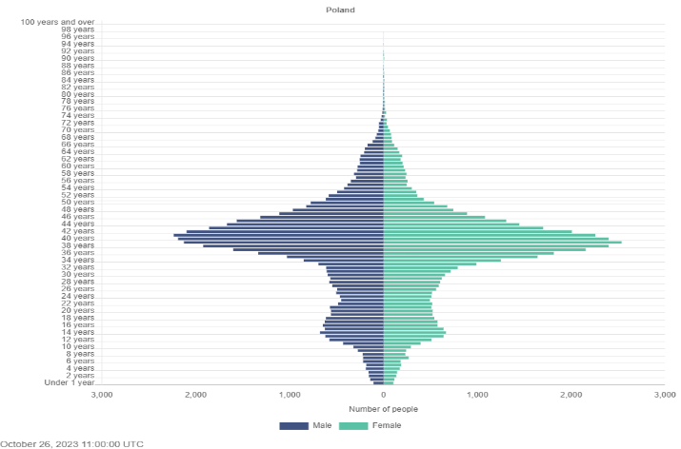
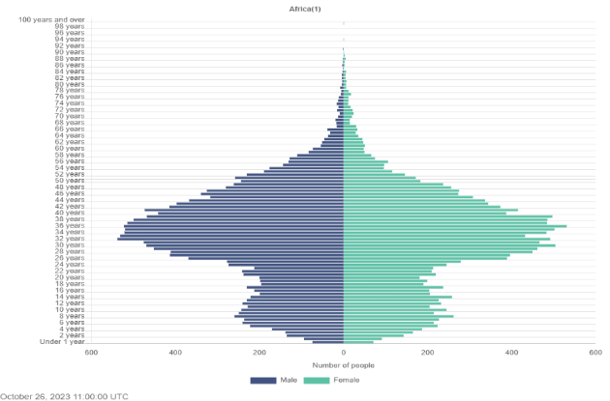
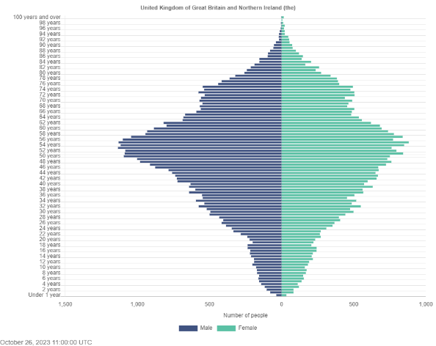
Age profile
Indian
Brazilian
Ukranian
Polish
Africa
UK
Notes:
Plus side of migration is the increase in working age numbers and children! This is a slide from the CSO – kindly donate by Cormac Halpin.

Slide 37
Ireland is looking and sounding different.
Census 2022 finds that
88% of the population are Irish citizens. 77% identified as White Irish.
More than 750,000 people spoke a language other than English or Irish at home.
About 95,000 say that they can’t speak English well or at all.
Looking only at Irish citizens, 30,000 Irish citizens said they can’t speak English well and another 5,000 said they can’t speak English at all – that’s 35,000 Irish citizens with spoken English difficulties, let alone literacy issues.
Notes:
Ireland is changing.
The look of people in Ireland is changing.
20% (check stats) of the population on Census night was not born in Ireland – a similar trend is evident in the labour force where a fifth of workers are not-Irish citizens.
The next largest ethnic group was Any Other White background (10%), followed by Indian/Pakistani/ Bangladeshi (2%), and Black or Black Irish (1%).
most commonly spoken languages being Polish, Romanian, French, Spanish and Portuguese

Slide 38
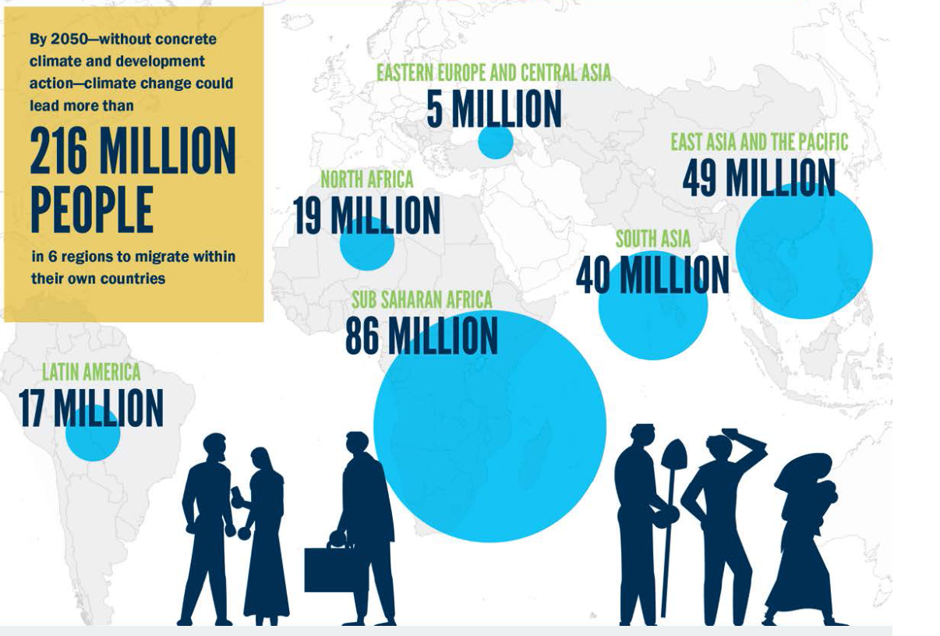
Notes:
What do we anticipate with climate change? Very high movements of people but evidence suggests that this movement is primarily internal within countries and continents. Future is uncertain.

Slide 39
The big picture

Slide 40
We socially protect everyone in Ireland.

Slide 41
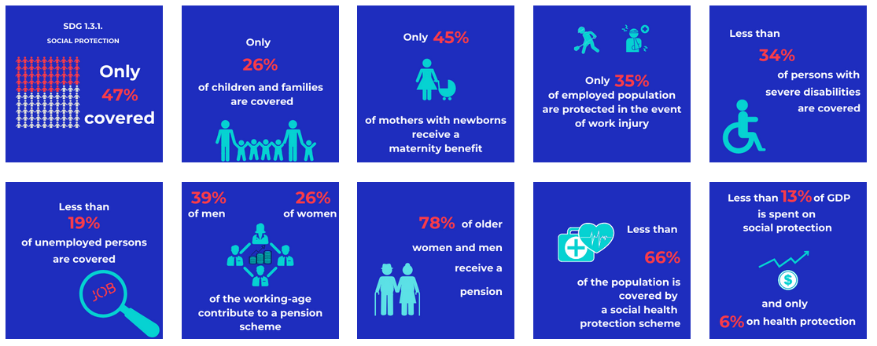

Slide 42
